Slide 1
Data Mining
Lecture 11

Slide 2
Course Syllabus
Classification Techniques (Week 7- Week 8- Week 9)
  Inductive Learning
  Decision Tree Learning
  Association Rules
  Neural Networks
  Regression
  Probabilistic Reasoning
  Bayesian Learning
Case Study 4: Working and experiencing on the properties of the classification infrastructure of Propensity Score Card System for The Retail Banking (Assignment 4) Week 9

Slide 3

Bayesian Learning
Bayes theorem is the cornerstone of Bayesian learning methods because it provides a way to calculate the posterior probability P(hlD), from the prior probability P(h), together with P(D) and P(D/h)

Slide 4
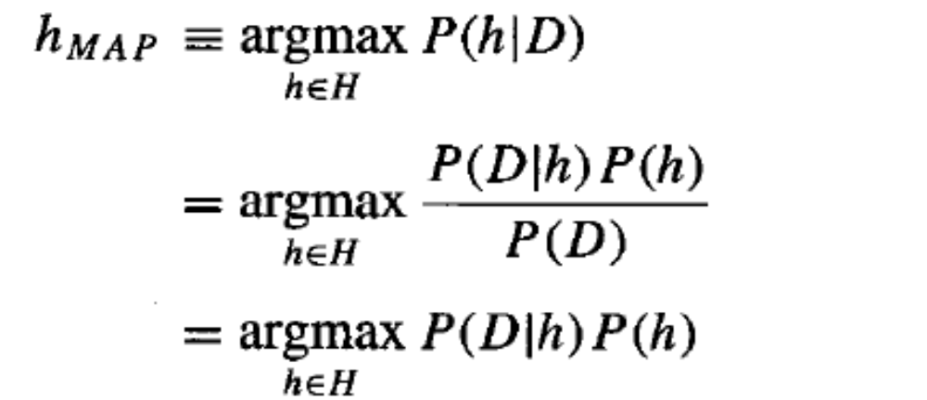
Bayesian Learning
finding the most probable hypothesis h E H given the observed data D (or at least one of the maximally probable if there are several). Any such maximally probable hypothesis is called a maximum a posteriori (MAP) hypothesis. We can determine the MAP hypotheses by using Bayes theorem to calculate the posterior probability of each candidate hypothesis. More precisely, we will say that MAP is a MAP hypothesis provided (in the last line we dropped the term P(D) because it is a constant independent of h)

Slide 5
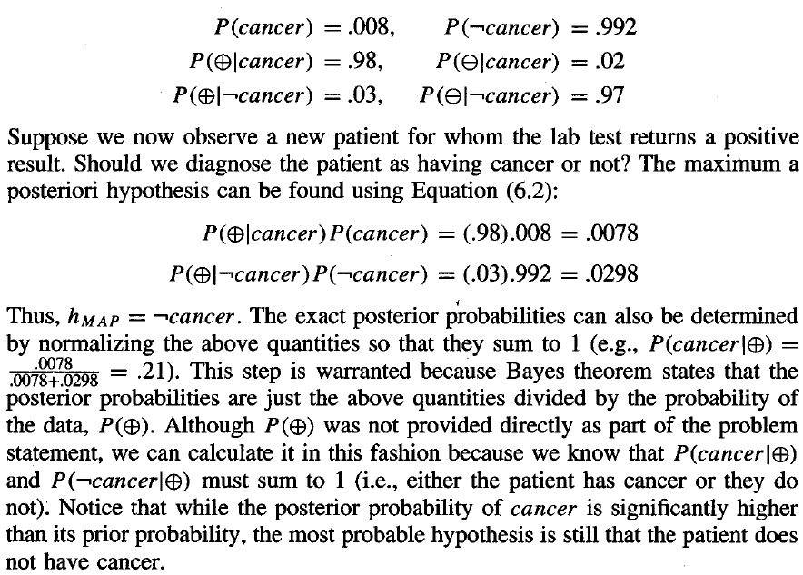
Bayesian Learning

Slide 6
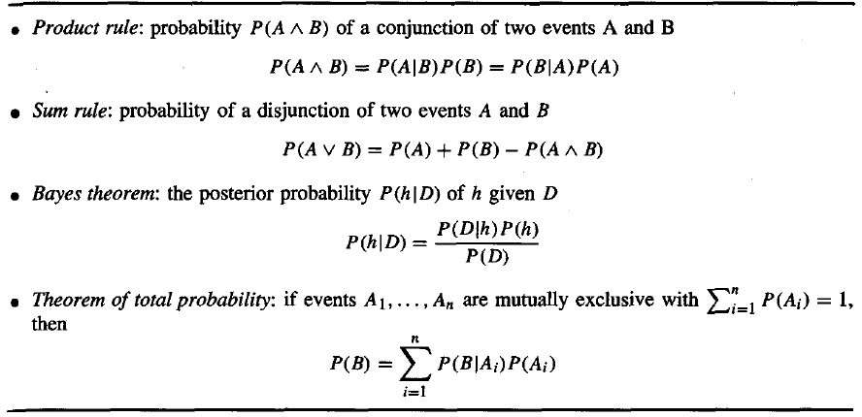
Probability Rules

Slide 7
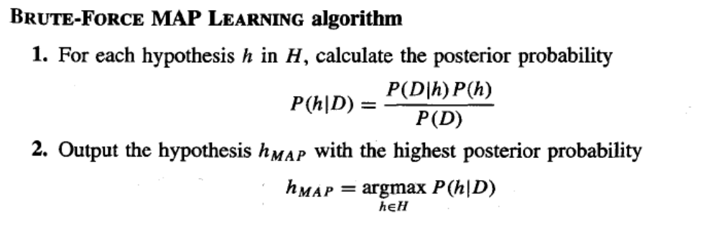
Bayesian Theorem and Concept Learning

Slide 8
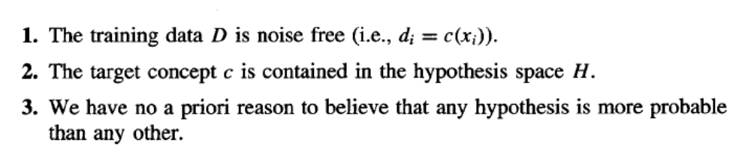
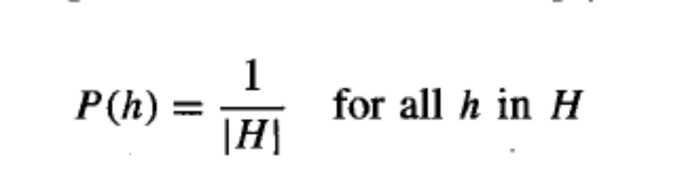
Bayesian Theorem and Concept Learning
Here let us choose them to be consistent with the following assumptions:
2. And 3. assumptions denote that

Slide 9
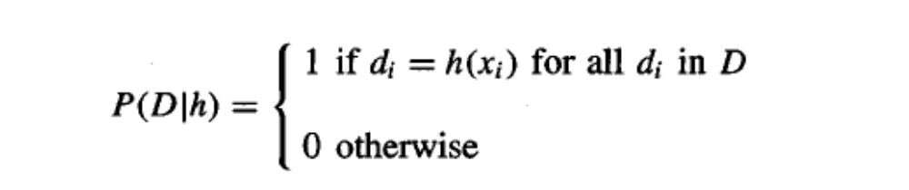
Bayesian Theorem and Concept Learning
Here let us choose them to be consistent with the following assumptions:
1. assumption denotes that

Slide 10
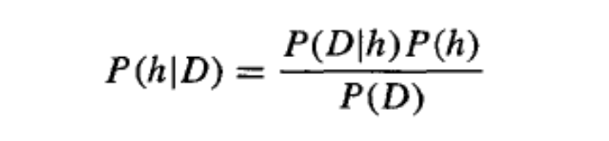

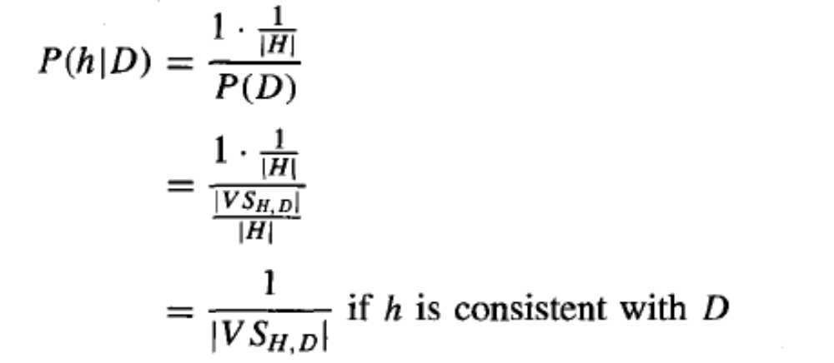
Bayesian Theorem and Concept Learning

Slide 11
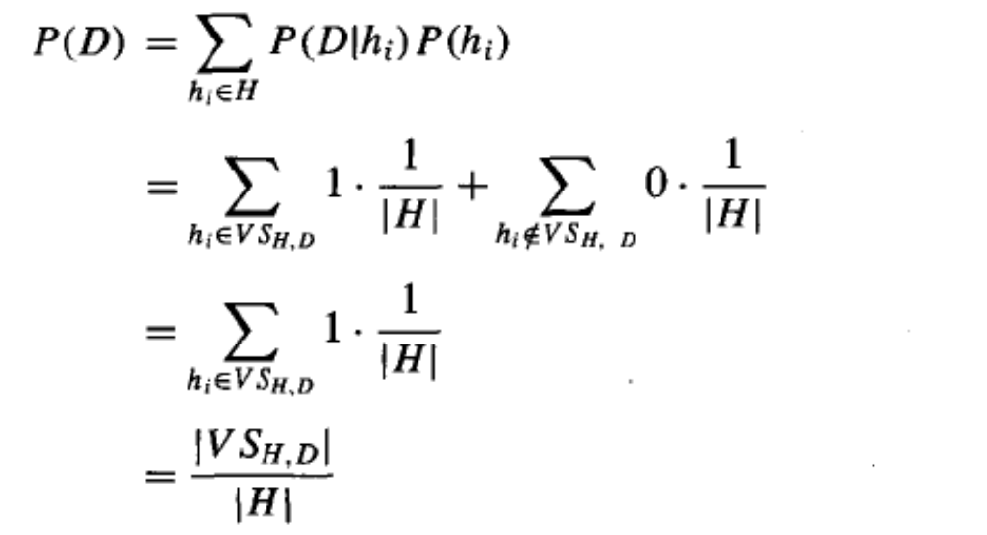
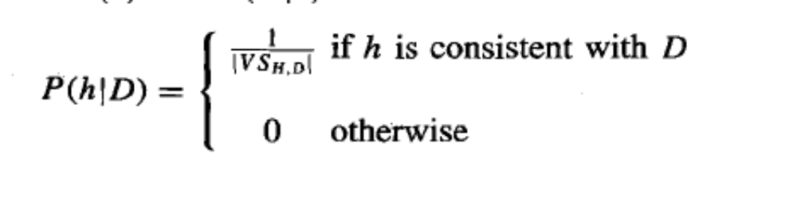
Bayesian Theorem and Concept Learning

Slide 12
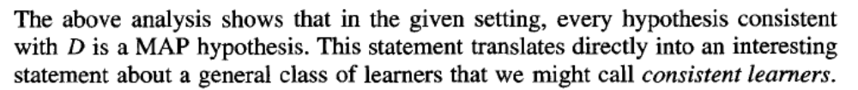
Bayesian Theorem and Concept Learning

Slide 13
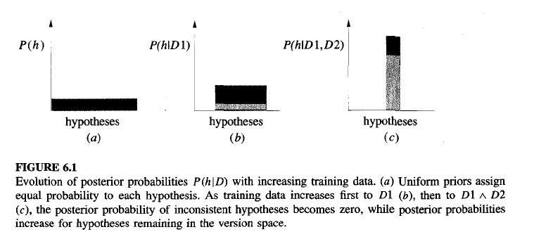
Bayesian Theorem and Concept Learning

Slide 14
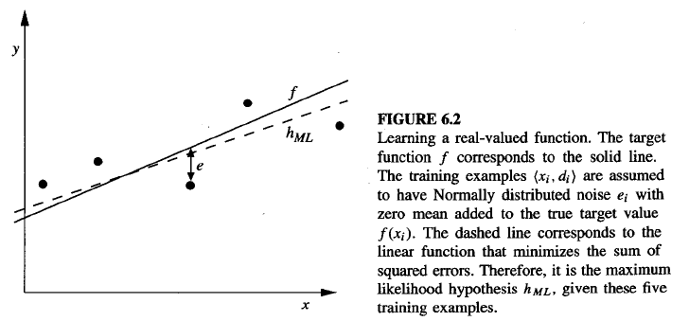
Bayesian Theorem and Concept Learning
our straightforward Bayesian analysis will show that under certain assumptions any learning algorithm that minimizes the squared error between the output hypothesis predictions and the training data will output a maximum likelihood hypothesis. The significance of this result is that it provides a Bayesian justification (under certain assumptions) for many neural network and other curve fitting methods that attempt to minimize the sum of squared errors over the training data.

Slide 15
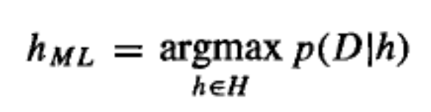
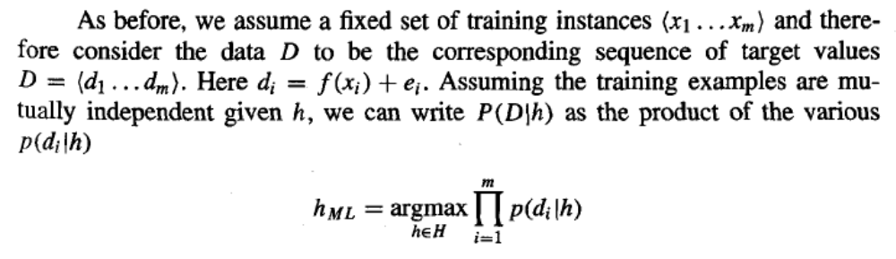
Bayesian Theorem and Concept Learning

Slide 16
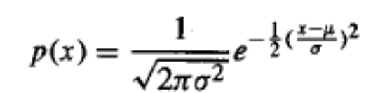
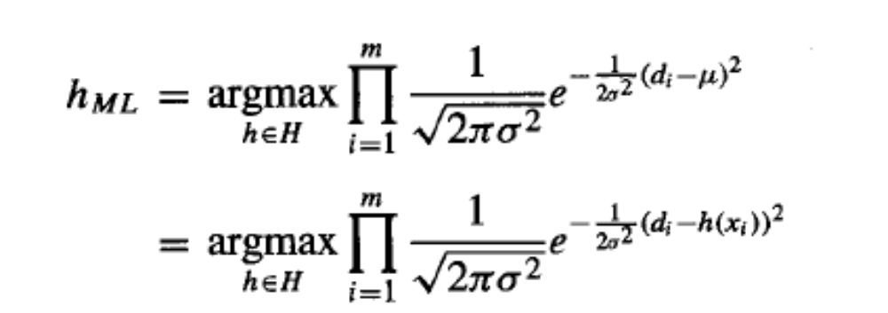
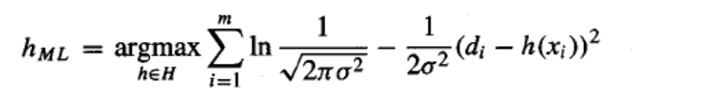
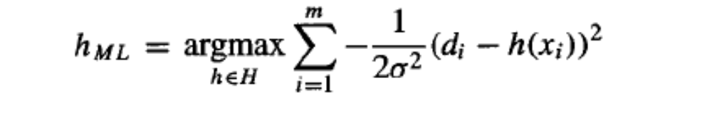

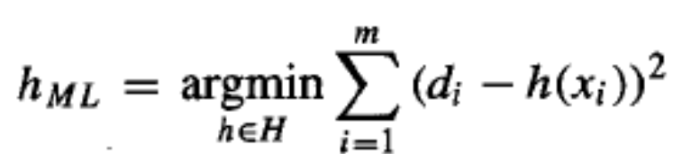
Bayesian Theorem and Concept Learning
Normal Distribution

Slide 17
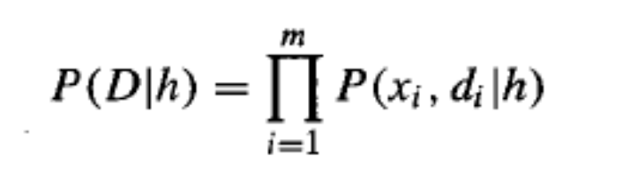

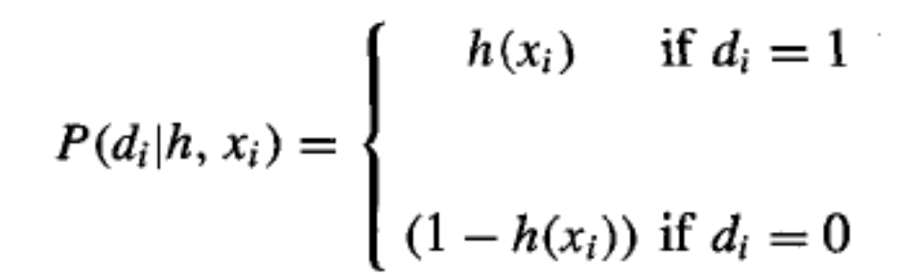

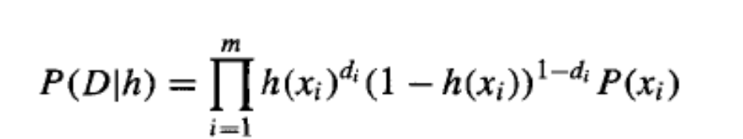
Bayesian Theorem and Concept Learning

Slide 18
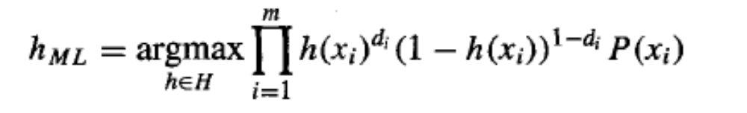
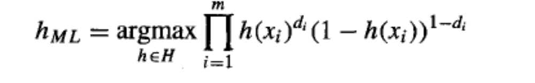
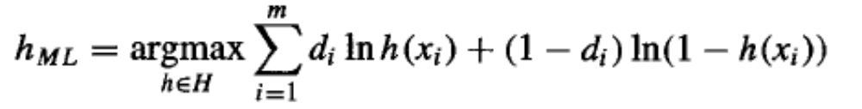

Bayesian Theorem and Concept Learning
Cross
Entropy
Note the similarity between above equation and the general form of the entropy function
Entropy

Slide 19
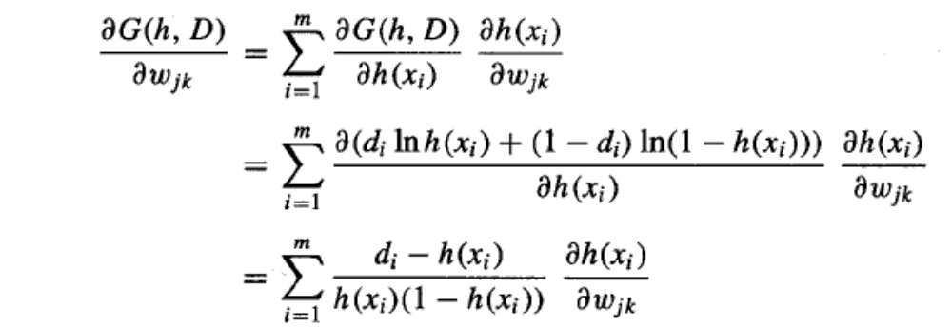
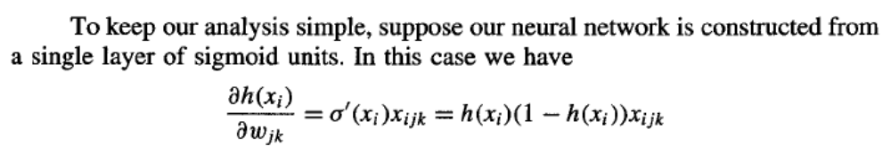
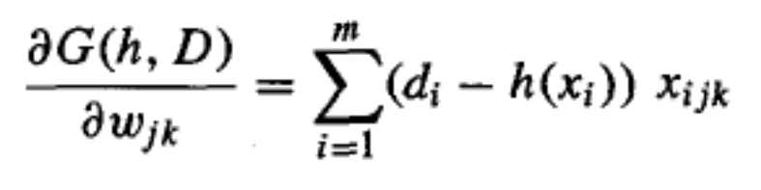
Gradient Search to Maximize Likelihood in a Neural Net

Slide 20
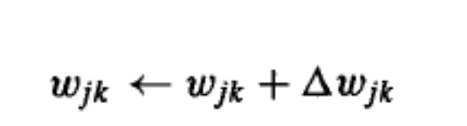
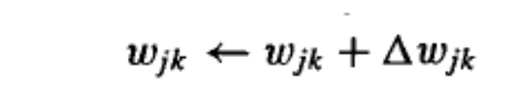
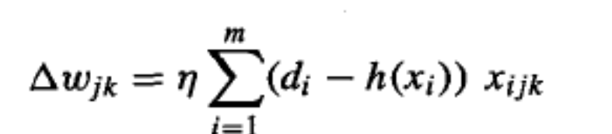
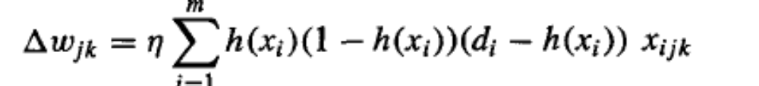
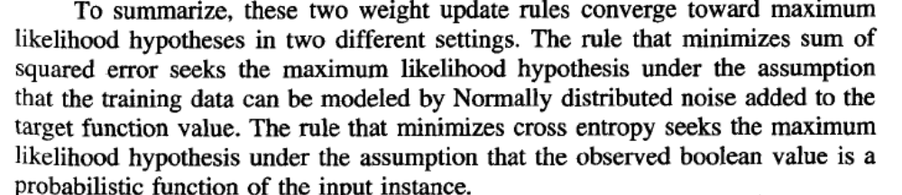
Gradient Search to Maximize Likelihood in a Neural Net
Cross Entropy Rule
Backpropogation Rule

Slide 21
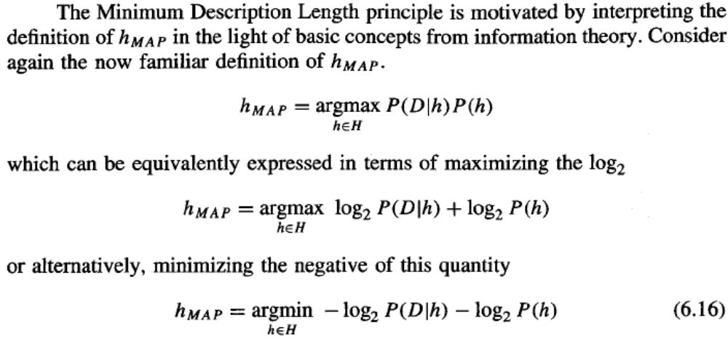
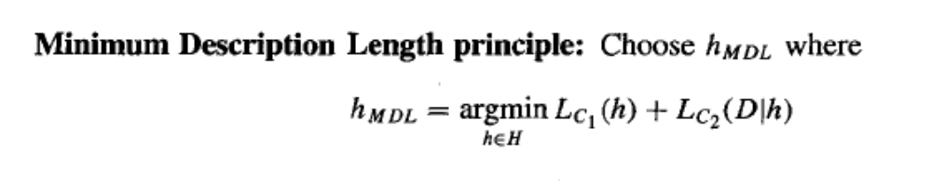
Minimum Description Length Principle

Slide 22
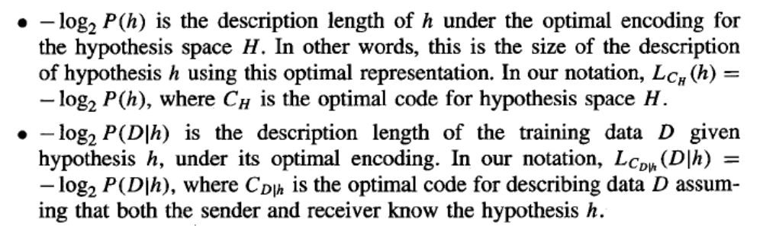
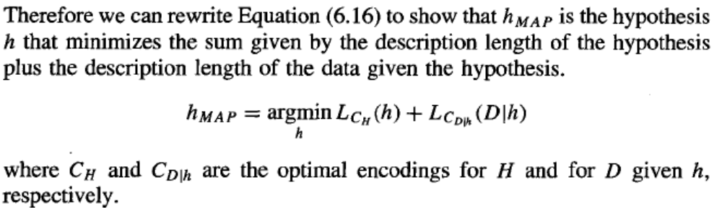
Minimum Description Length Principle

Slide 23
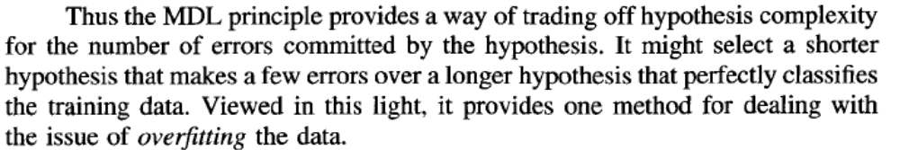
Minimum Description Length Principle

Slide 24
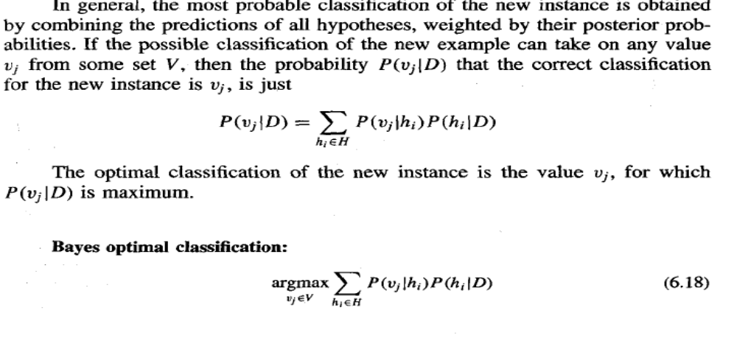
Bayes Optimal Classifier
So far we have considered the question "what is the most probable hypothesis given
the training data?' In fact, the question that is often of most significance is the closely
related question "what is the most probable classification of the new instance given
the training data?'Although it may seem that this second question can be answered by
simply applying the MAP hypothesis to the new instance, in fact it is possible to do better.

Slide 25
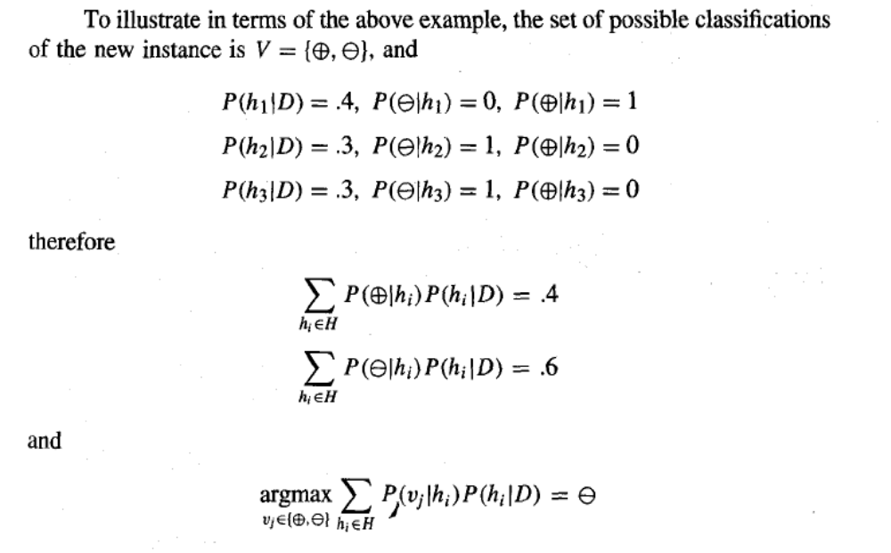
Bayes Optimal Classifier

Slide 26
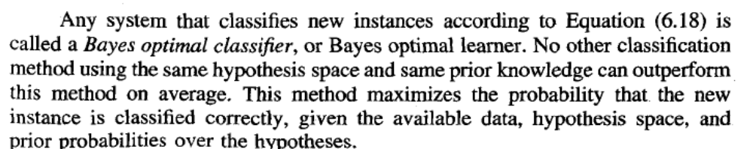
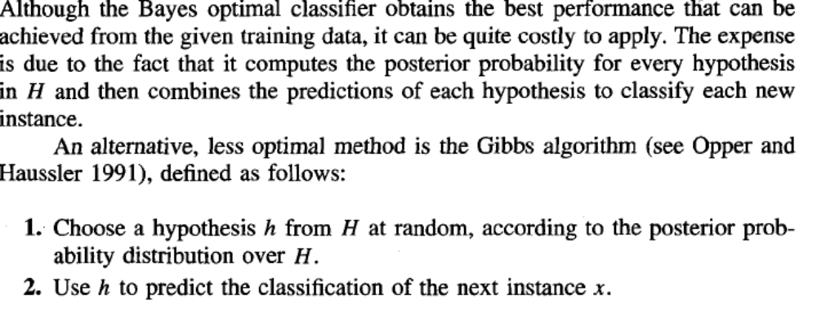
Bayes Optimal Classifier

Slide 27
Gibbs Algorithm
Surprisingly, it can be shown that under certain conditions the expected misclassification error for the Gibbs algorithm is at most twice the expected error of the Bayes optimal classifier

Slide 28
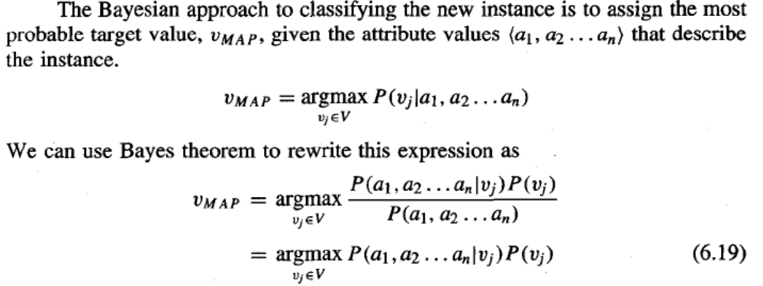

Naive Bayes Classifier

Slide 29
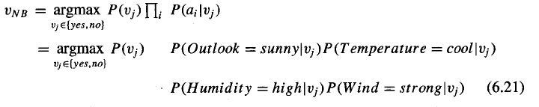
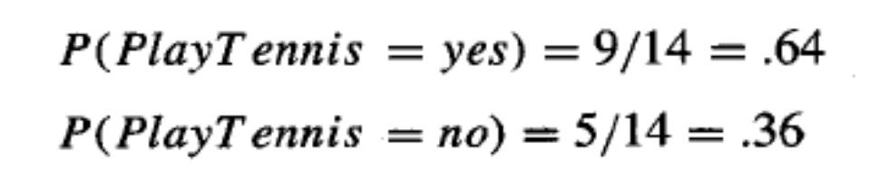
Naive Bayes Classifier – An Example
New Instance

Slide 30
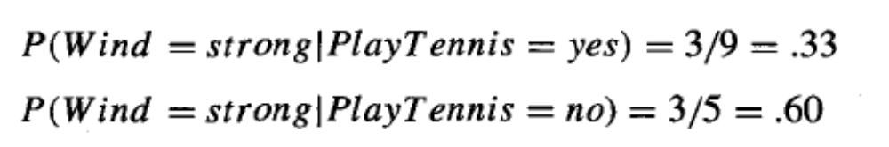


Naive Bayes Classifier – An Example
New Instance

Slide 31

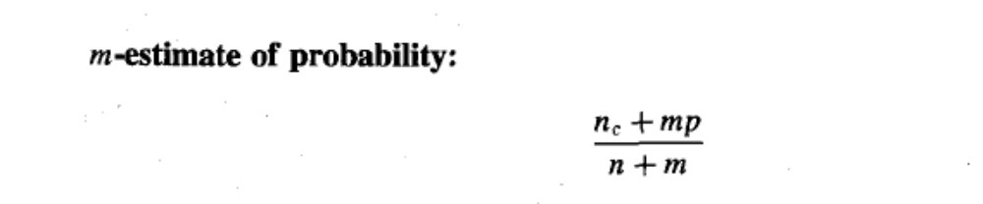
Naive Bayes Classifier – Detailed Look
What is wrong with the above formula ? What about zero nominator term; and multiplication
of Naive Bayes Classifier

Slide 32
Naive Bayes Classifier – Remarks
Simple but very effective strategy
Assumes Conditional Independence between attributes
of an instance
Clearly most of the cases this assumption erroneous
Especiallly for the Text Classification task it is powerful
It is an entrance point for Bayesian Belief Networks

Slide 33
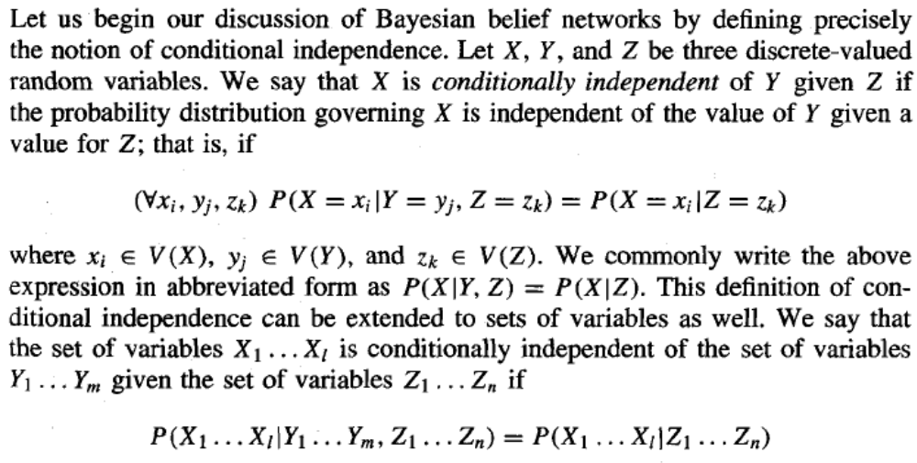
Bayesian Belief Networks

Slide 34

Bayesian Belief Networks

Slide 35

Bayesian Belief Networks

Slide 36

Bayesian Belief Networks

Slide 37


Bayesian Belief Networks

Slide 38
Bayesian Belief Networks-Learning
Can we device effective algorithm for Bayesian Belief Networks ?
Two different parameters we must care about
-network structure
-variables observable or unobservable
When network structure unknown; it is too difficult
When network structure known and all the variables observable
Then it is straightforward just apply Naive Bayes procedure
When network structure known but some variables unobservable
It is analogous learning the weights for the hidden units in an artificial
neural network, where the input and output node values are given but
the hidden unit values are left unspecified by the training examples

Slide 39
Bayesian Belief Networks-Learning
Can we device effective algorithm for Bayesian Belief Networks ?
Two different parameters we must care about
-network structure
-variables observable or unobservable
When network structure unknown; it is too difficult
When network structure known and all the variables observable
Then it is straightforward just apply Naive Bayes procedure
When network structure known but some variables unobservable
It is analogous learning the weights for the hidden units in an artificial
neural network, where the input and output node values are given but
the hidden unit values are left unspecified by the training examples

Slide 40
Bayesian Belief Networks-Gradient Ascent Learning
We need gradient ascent procedure searches through a space of hypotheses that corresponds to the set of all possible entries for the conditional probability tables. The objective function that is maximized during gradient ascent is the probability P(D/h) of the observed training data D given the hypothesis h. By definition, this corresponds to searching for the maximum likelihood hypothesis for the table entries.

Slide 41

Bayesian Belief Networks-Gradient Ascent Learning
Let’s use
instead of
for clearity

Slide 42

Bayesian Belief Networks-Gradient Ascent Learning
Assuming the training examples d in the data set D are drawn independently, we write this derivative as

Slide 43

Bayesian Belief Networks-Gradient Ascent Learning

Slide 44

Bayesian Belief Networks-Gradient Ascent Learning

Slide 45

Bayesian Belief Networks-Gradient Ascent Learning

Slide 46

EM Algorithm – Basis of Unsupervised Learning Algorithms

Slide 47

EM Algorithm – Basis of Unsupervised Learning Algorithms

Slide 48

EM Algorithm – Basis of Unsupervised Learning Algorithms

Slide 49


EM Algorithm – Basis of Unsupervised Learning Algorithms
Step 1 is easy:

Slide 50

EM Algorithm – Basis of Unsupervised Learning Algorithms
Let’s try to understand
the formula
Step 2:

Slide 51


EM Algorithm – Basis of Unsupervised Learning Algorithms
for any function f (z) that is a linear function of z, the following equality holds

Slide 52



EM Algorithm – Basis of Unsupervised Learning Algorithms

Slide 53

EM Algorithm – Basis of Unsupervised Learning Algorithms

Slide 54
End of Lecture
read Chapter 6 of Course Text Book
read Chapter 6 – Supplemantary Text Book “Machine Learning” – Tom Mitchell

